Slide 2
Virtual Private Cloud (VPC)
多重備援的神奇魔力
講義與實作文件下載處

Slide 3


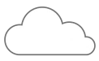


Virtual Private Cloud (VPC)
VPC is a space on a public cloud that allows you to define a virtual private network where you deploy, secure, control and manage cloud resources dedicated to your business.
VPC
VPC is your own space in the cloud
VPC
VPC
VPC
Public Cloud

Slide 4
Accelerate non-disruptive cloud adoption and migration with VPCs
VPCs enable native Bring-Your-own-IP (BYoIP) address range for non-disruptive connectivity of cloud and on-premises resources
IP Address Range
Flexible migration of workloads that uses advertised IP address prefixes to the IBM Cloud
Simpler VPCs with bring your own private IP without NAT or Tunnels
Non-disruptive on-premises cconnectivity without changes to existing networking environments
Keep Traffic flowing from endpoints that use the private IP address through services that utilize IP address reputation

Slide 5

Expand your workload options with VPCs
VPC enables business applications workloads to easily migrate to the cloud, or just burst into the cloud as needed. Availability Zones (AZ) with no shared points of failure keep your workloads available.
VPC is available in multiple regions with multiple AZs in each region for higher availability
Allow clients to scale as needed with MZRs without worrying about resources or capacity
Utilize private service endpoints that connect to a number of IBM Public Cloud services

Slide 6




Building blocks of a VPC
IBM Cloud
Region
PUBLIC
GATEWAY
VPN
ROUTER
FIP
FLOATING IP
Zone 1
LOAD BALANCER
DIRECT LINK
VIRTUAL
MACHINE
BLOCK
STORAGE
Subnet
ACL
Security Group
Subnet

Slide 7


VPC Features
KEY
Regions, Availability Zones and Subnets
VIRTUAL
MACHINE
PUBLIC
NETWORK
CLOUD
NETWORK
ENTERPRISE
NETWORK
BLOCK
STORAGE
Region
Region
REGION
ZONE
Zone 1
Zone 2
Zone 1
SUBNET
Subnet 1
10.0.1.0/24
Subnet 3
10.0.3.0/24
Subnet 1
10.0.1.0/24
INTERNET
Subnet 2
10.0.2.0/24
Subnet 4
10.0.4.0/24
ON PREMISE
Subnet 2
10.0.2.0/24

Slide 8
VPC Features
KEY
Network Security – ACLs and SGs
VIRTUAL
MACHINE
PUBLIC
NETWORK
CLOUD
NETWORK
ENTERPRISE
NETWORK
BLOCK
STORAGE
REGION
Region
ZONE
Zone 1
Zone 2
SUBNET
Subnet 1
10.0.1.0/24
Subnet 3
10.0.3.0/24
ACL
SECURITY GROUP
INTERNET
Subnet 2
10.0.2.0/24
Subnet 4
10.0.4.0/24
ON PREMISE

Slide 9
VPC Features
KEY
Connectivity – Public Gateway and FIPs
VIRTUAL
MACHINE
PUBLIC
NETWORK
CLOUD
NETWORK
ENTERPRISE
NETWORK
BLOCK
STORAGE
REGION
Region – US South
ZONE
Zone 1
Zone 2
SUBNET
Subnet 1
10.0.1.0/24
Subnet 3
10.0.3.0/24
ACL
SECURITY GROUP
INTERNET
FIP
Subnet 2
10.0.2.0/24
Subnet 4
10.0.4.0/24
ON PREMISE
PUBLIC
GATEWAY

Slide 10

VPC Features
KEY
Load Balancing – Load Balancer and CIS
VIRTUAL
MACHINE
PUBLIC
NETWORK
CLOUD
NETWORK
ENTERPRISE
NETWORK
BLOCK
STORAGE
REGION
Region – US South
ZONE
Zone 1
Zone 2
SUBNET
Subnet 1
10.0.1.0/24
Subnet 3
10.0.3.0/24
ACL
SECURITY GROUP
INTERNET
FIP
Subnet 2
10.0.2.0/24
Subnet 4
10.0.4.0/24
ON PREMISE
PUBLIC
GATEWAY
LB
CIS

Slide 11

VPC Features
KEY
Storage – Block and COS
VIRTUAL
MACHINE
PUBLIC
NETWORK
CLOUD
NETWORK
ENTERPRISE
NETWORK
BLOCK
STORAGE
REGION
Region – US South
ZONE
Zone 1
Zone 2
SUBNET
Subnet 1
10.0.1.0/24
Subnet 3
10.0.3.0/24
ACL
SECURITY GROUP
INTERNET
FIP
Subnet 2
10.0.2.0/24
Subnet 4
10.0.4.0/24
ON PREMISE
PUBLIC
GATEWAY
LB
CIS
COS

Slide 12
VPC Features
KEY
Connectivity – VPN and Direct Link
VIRTUAL
MACHINE
PUBLIC
NETWORK
CLOUD
NETWORK
ENTERPRISE
NETWORK
BLOCK
STORAGE
REGION
Region – US South
ZONE
Zone 1
Zone 2
SUBNET
Subnet 1
10.0.1.0/24
Subnet 3
10.0.3.0/24
ACL
SECURITY GROUP
INTERNET
ON PREMISE
FIP
Subnet 2
10.0.2.0/24
Subnet 4
10.0.4.0/24
PUBLIC
GATEWAY
LB
CIS
DIRECT LINK
VPN

Slide 13
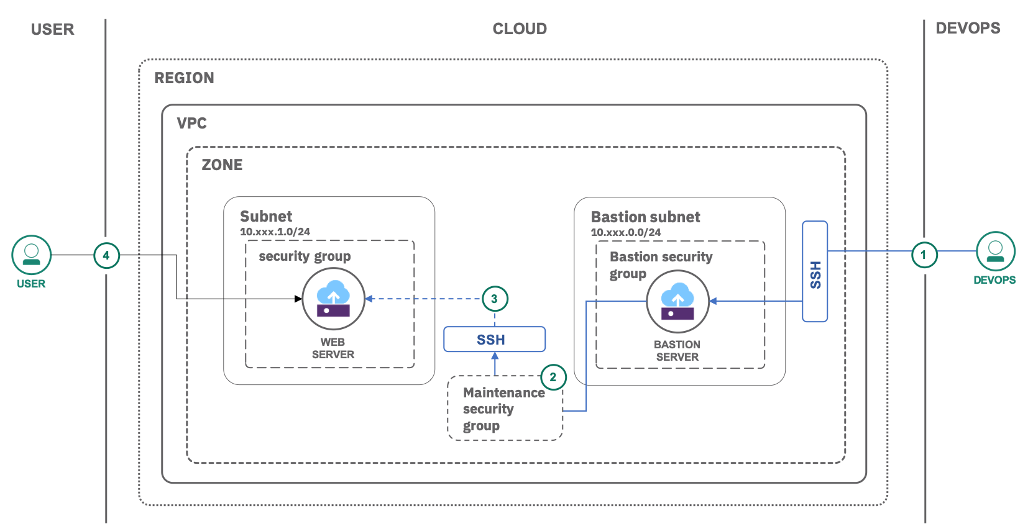
VPC 實作
Securely access remote instances with a bastion host
IaasPaas Workshop - VPC.pdf

Slide 14
Jack Wu
scwu@tw.ibm.com

